Slide 1
Using Twitter to Predict Presidential Polling Outcomes
Supervised Learning capstone
Thinkful 2019
Emily boyes

Slide 2
How can Twitter and sentiment analysis along with political donation data help to predict polling outcomes and ultimately the winner of presidential primaries?

Slide 3
Background & Data
Chose the four candidates with the highest amount of funding as of September 2019 AND September 2015
Biden, Buttigieg, Sanders, Warren
Clinton, Cruz, Sanders, Trump
Goal was to make a prediction for the Democratic nominee for the 2020 Presidential election cycle using past data from 2015 for training
The data was obtained through the process of running the command 'GetOldTweets3' and 'Twint' through the command line with parameters:
All tweets containing candidate name strings for the first week (days 1 - 7) of May, June, July, August, and September of 2019. The same was repeated for 2015.
Over 3 million tweets were collected
Other data was taken from national polling data for 2019 and 2015 and donation and financial data was taken from the official FEC database
Used the NLK toolkit TextBlob
Returns sentiment values for words and phrases of the form Sentiment(polarity, subjectivity)
Polarity—float within the range [-1.0, 1.0] where -1 is the most negative, 1 is the most positive and 0 is neutral
Subjectivity—float within the range [0.0, 1.0] where 0.0 is very objective and 1.0 is very subjective.

Slide 4
Features
Column | Description
month/year | MM-YYYY
candidate | Candidate last name
next_month_polls | Aggregated polling data from the next month
polarity | Average polarity per candidate and month
weighted_polarity | ((reactions/30) + 1) * polarity
num_tweets | Total number of tweets containing that candidate only for each month
replies | Total number of replies for tweets containing that candidate only for each month
retweets | Total number of retweets
favorites | Total number of favorites
num_reactions | Replies + retweets + favorites
donations | Total $ per month for each candidate
tweets_per_hour | Total tweets per day/24 for each of the 7 days, then choose the max of the 7

Slide 5
Data Wrangling & Organization
Two types of tweets: tweets that contained only 1 candidate’s name (no overlap) and tweets where there was overlap with at least one of the other 3 candidates
Used tweets with no overlap for sentiment value and tweets with overlap for total counts
No rows were dropped because there were no columns with missing data, even though some tweets might have been missing
Polling data was taken from Wikipedia and contained a variety of sources. Data for the entire month was averaged since polls are conducted over various time spans, often around a week
All donations are taken from the FEC database, which contains every donation from every person or entity who has donated to a candidate
Ultimately 3 million rows of data were whittled down to 40 rows

Slide 6
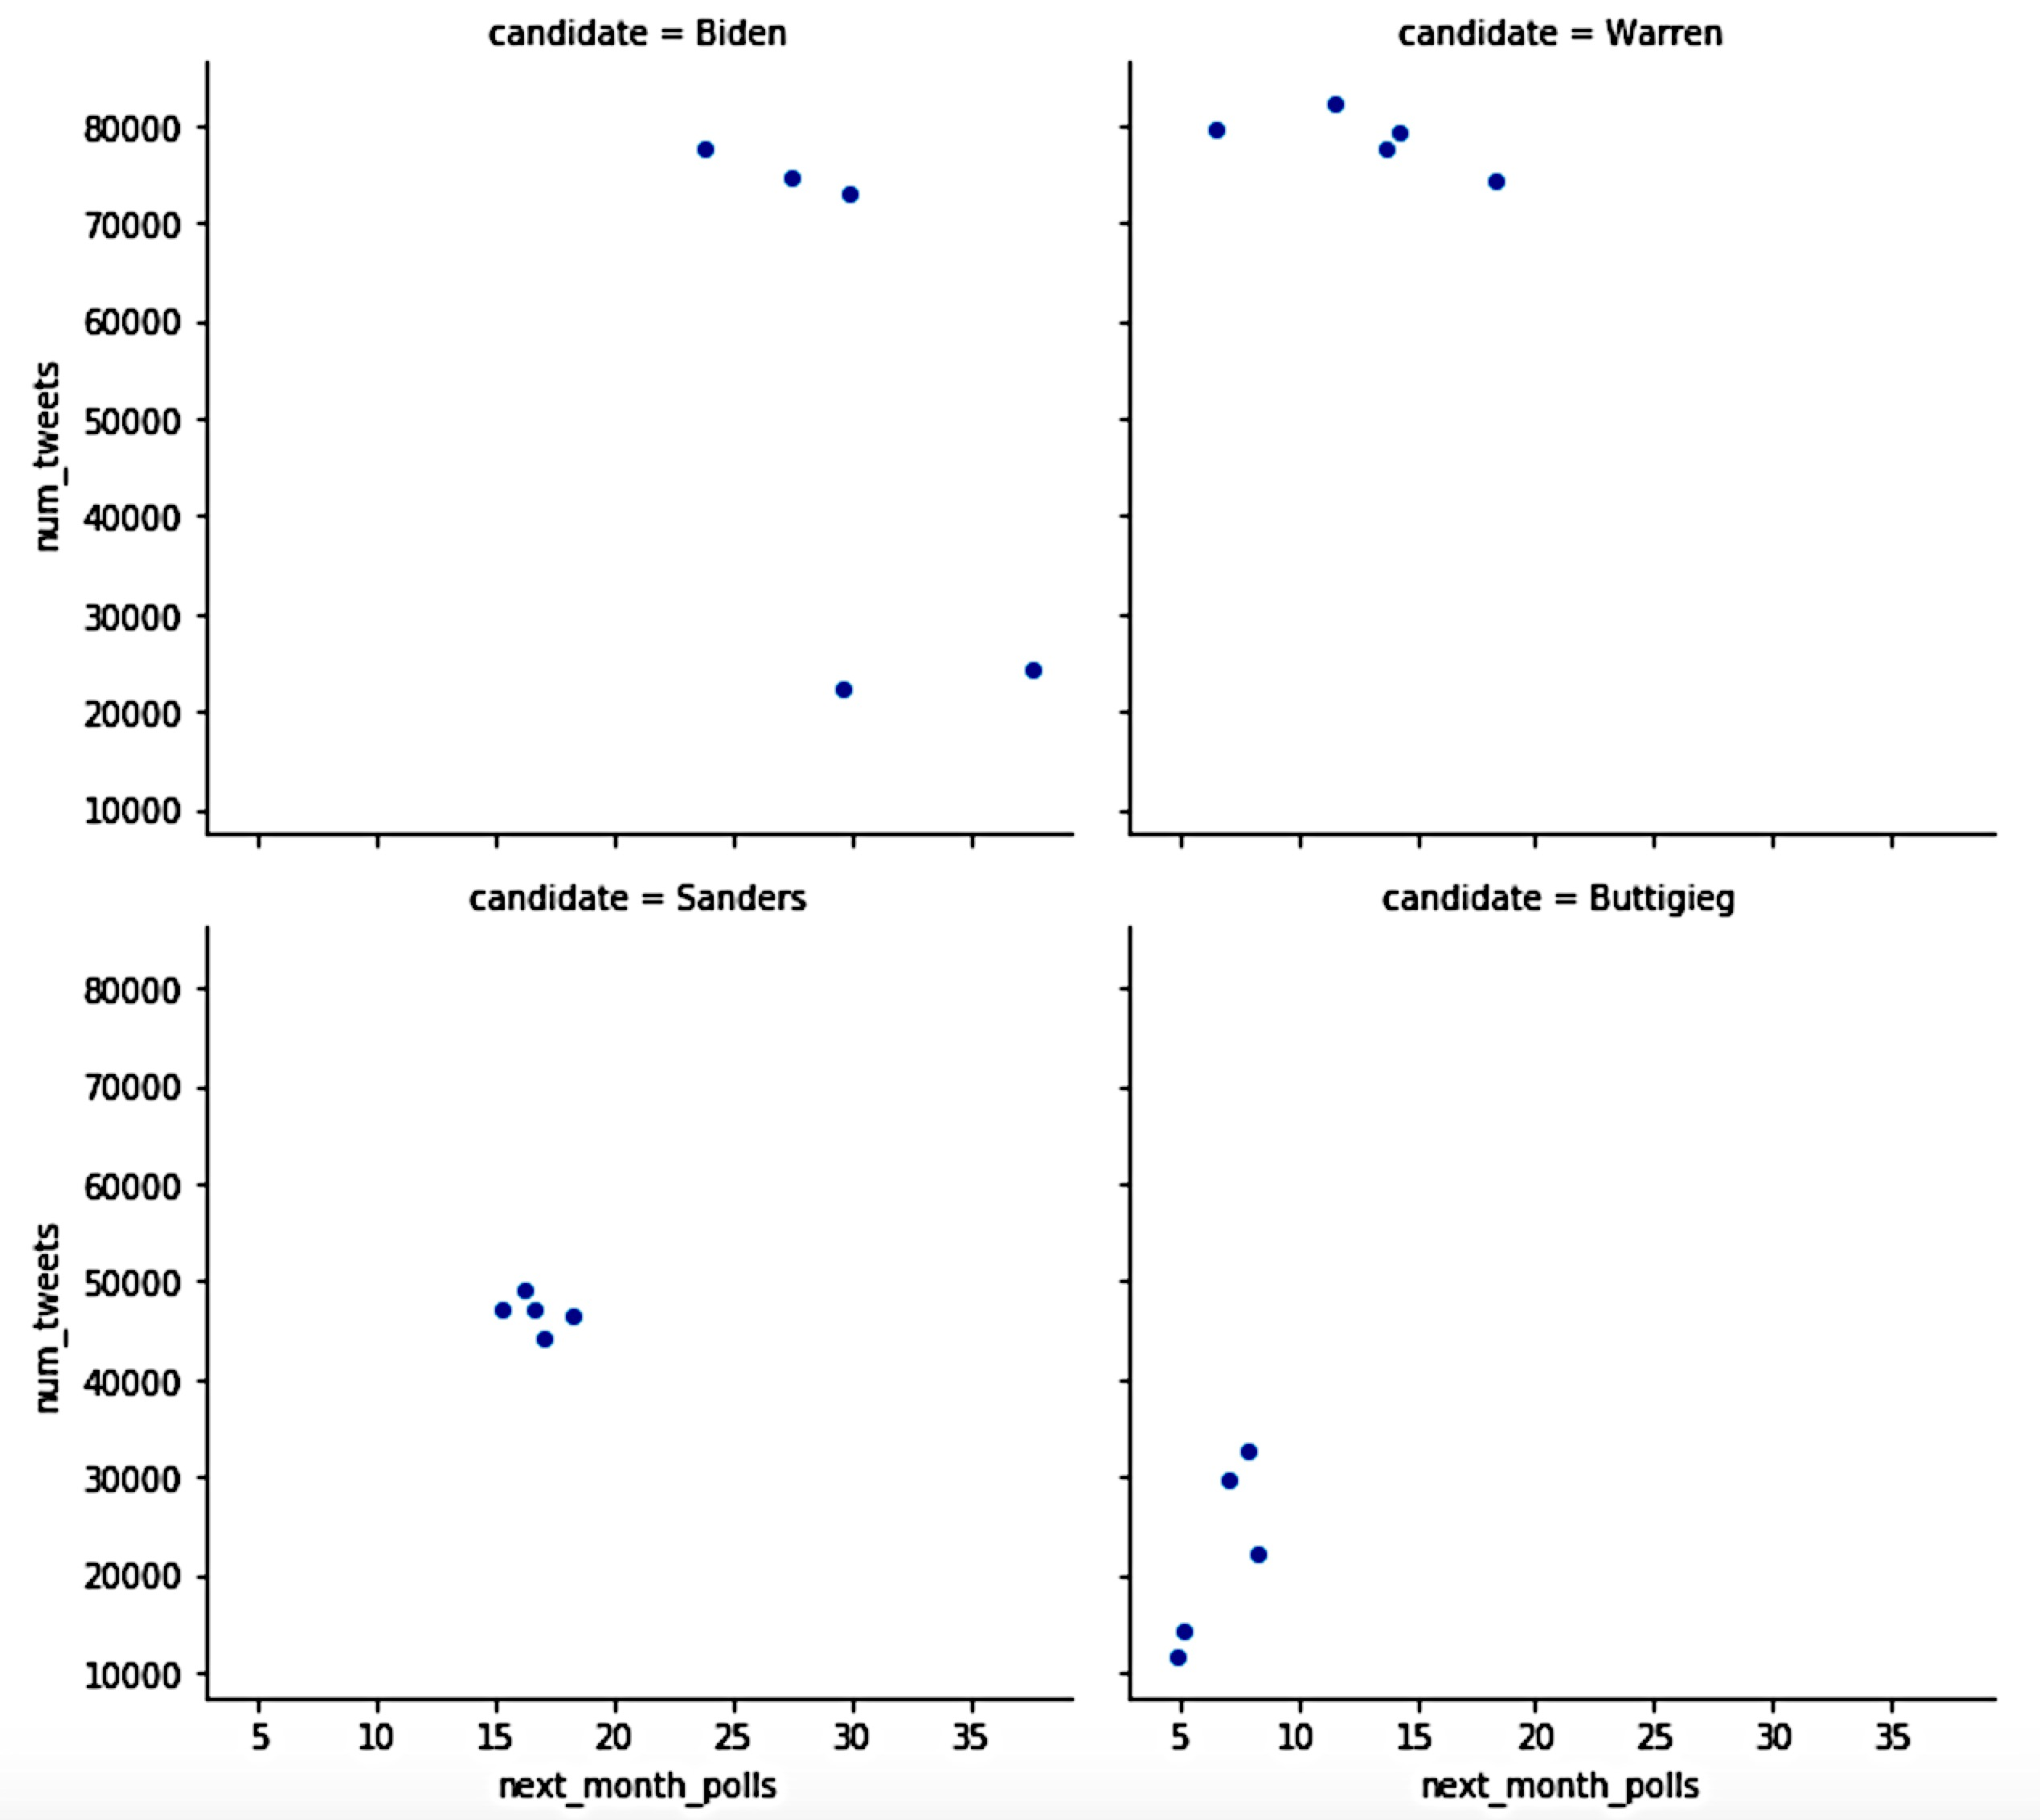
Visualizations Next Month’s Polls vs. Number of Tweets

Slide 7
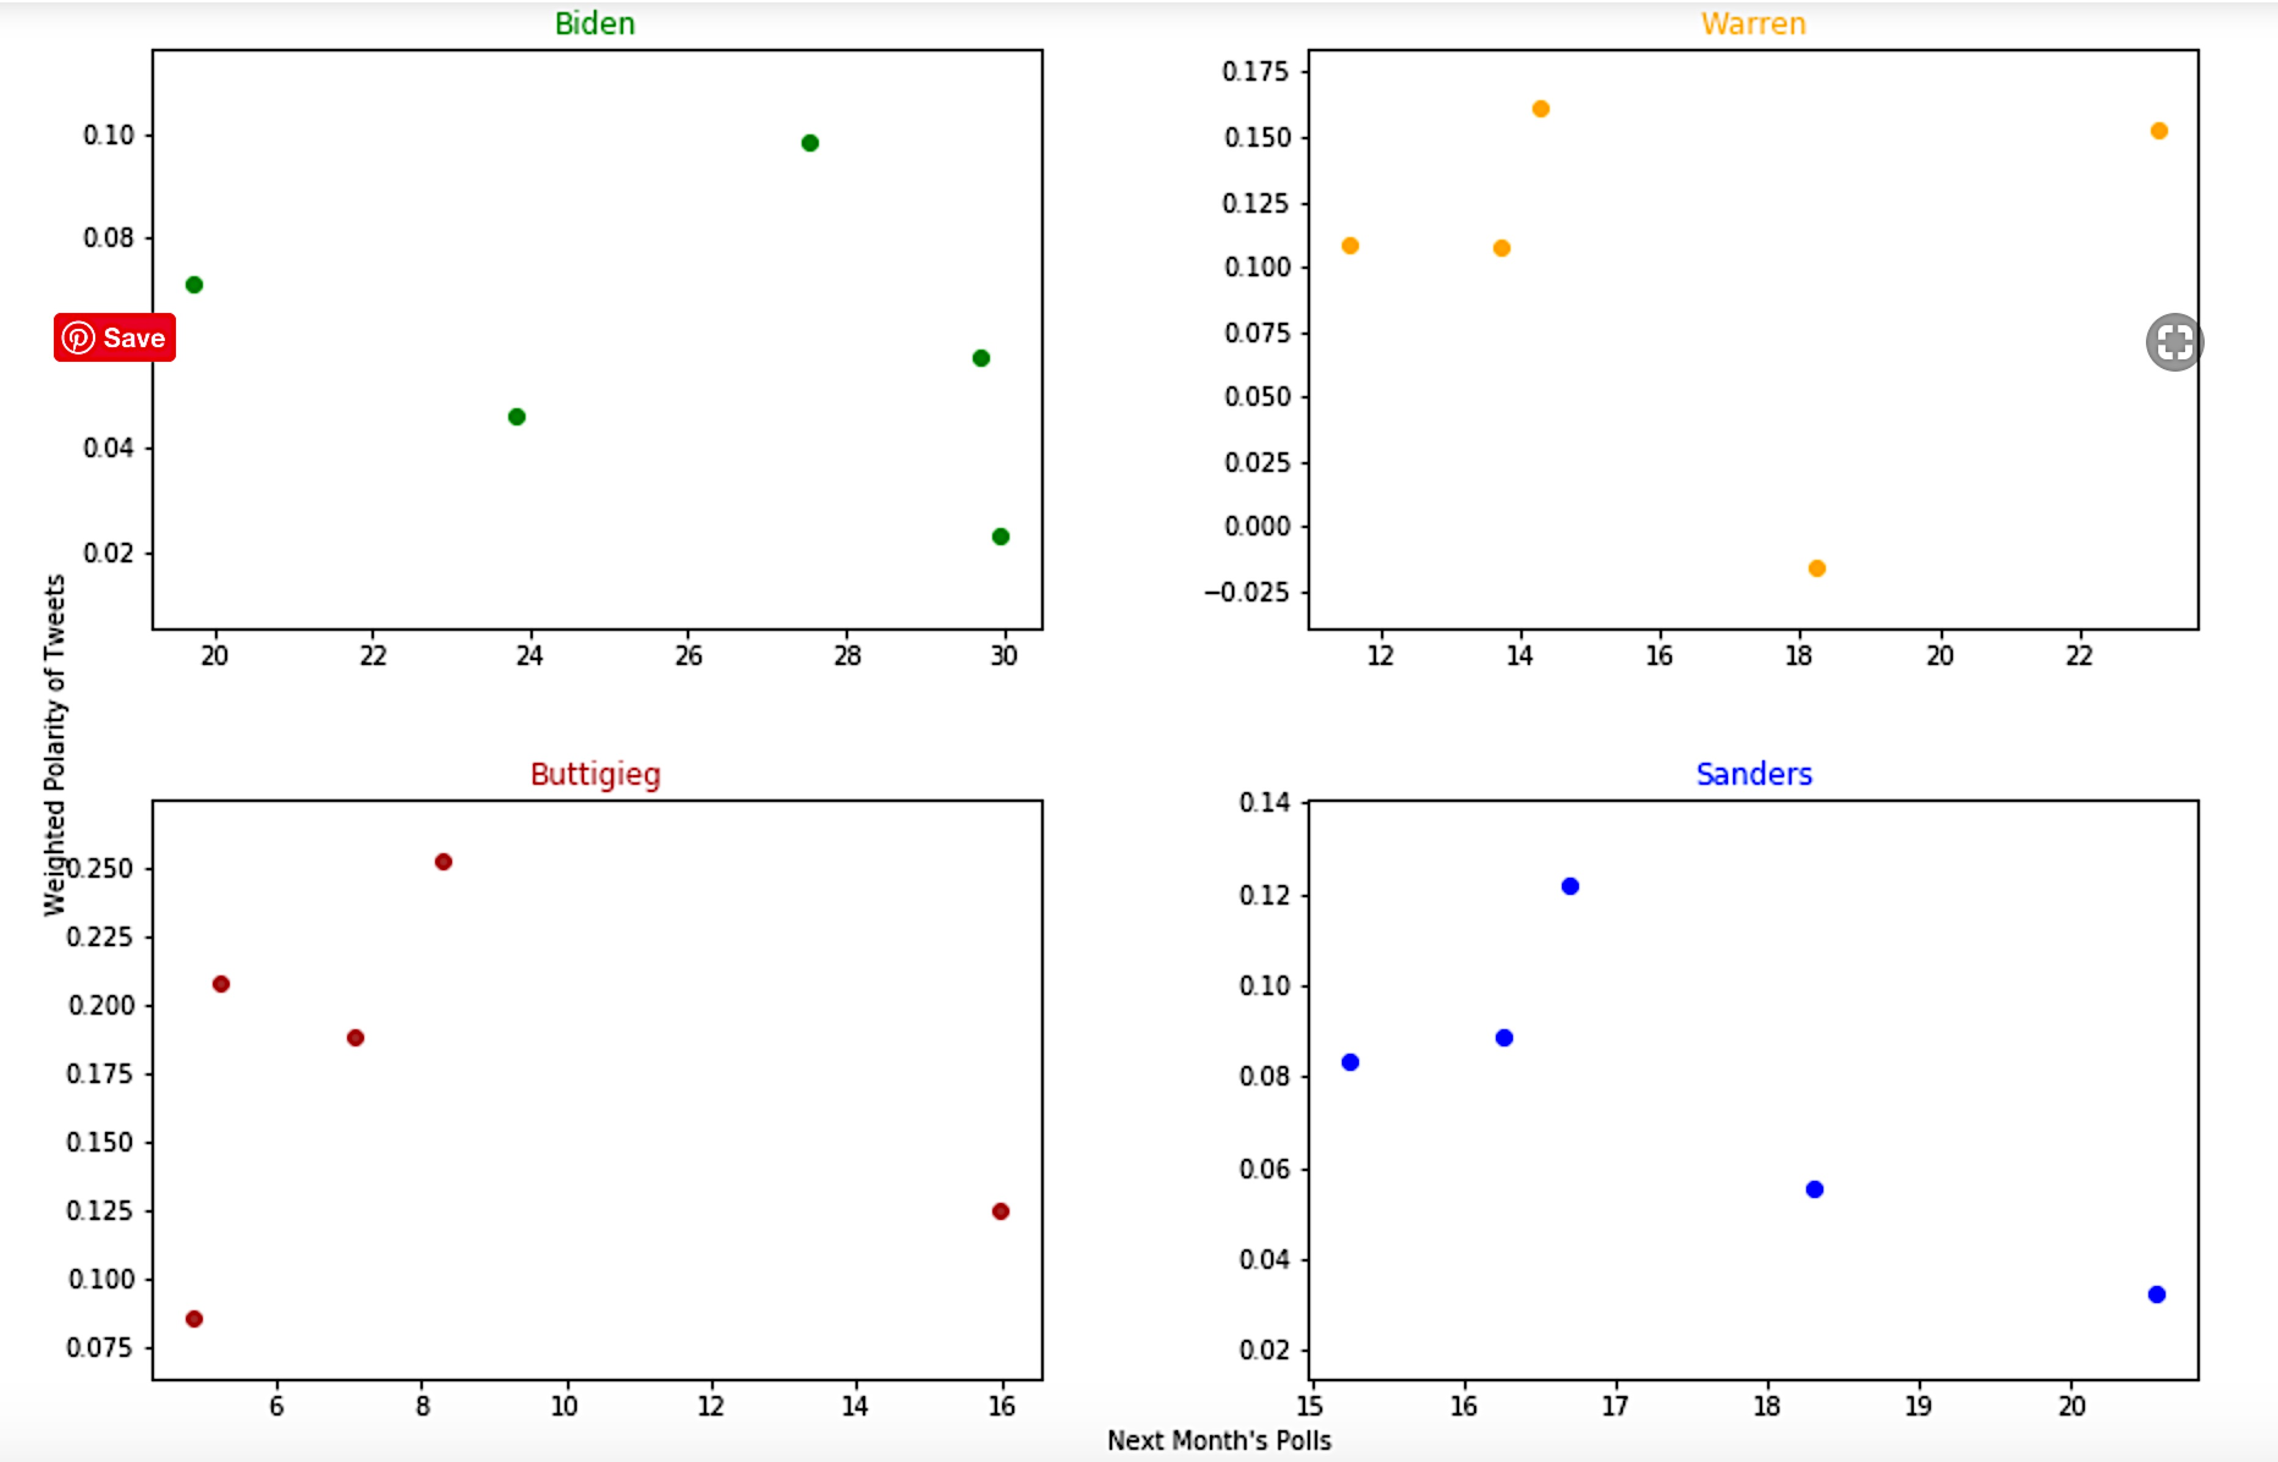
Visualizations Next Month’s Polls vs. Weighted Polarity

Slide 8
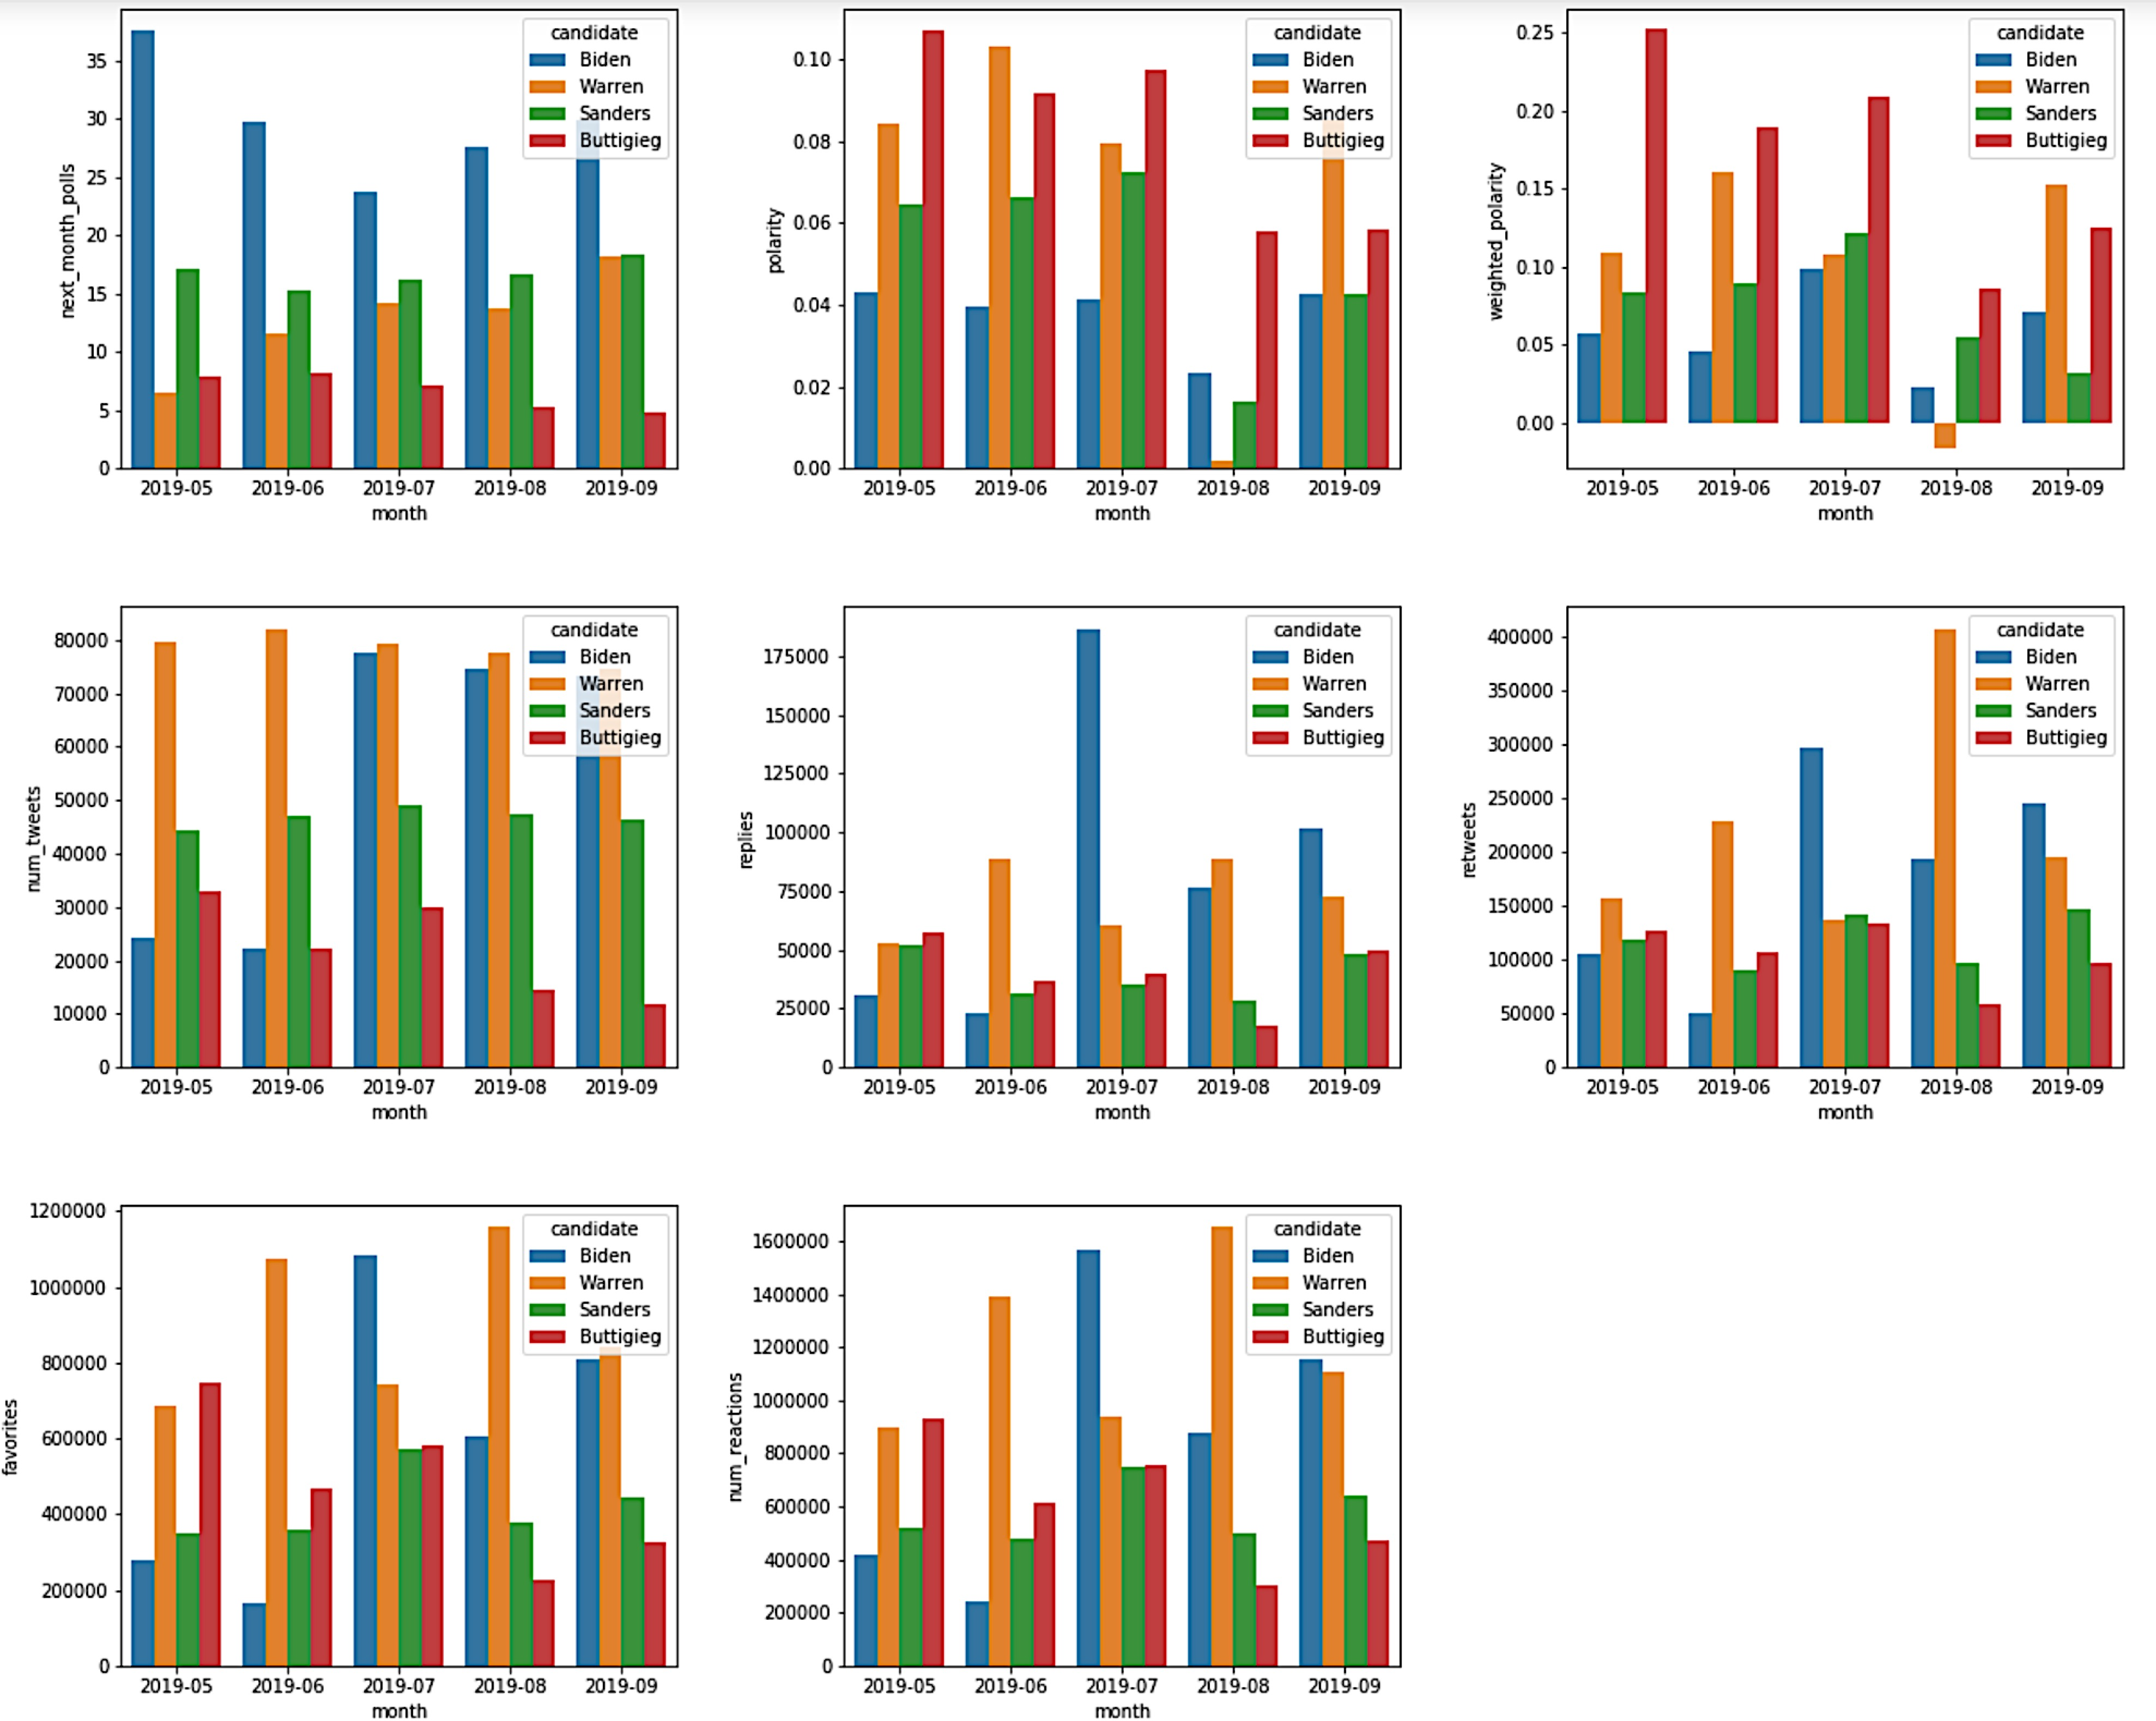
Visualizations Features by Month and Candidate

Slide 9
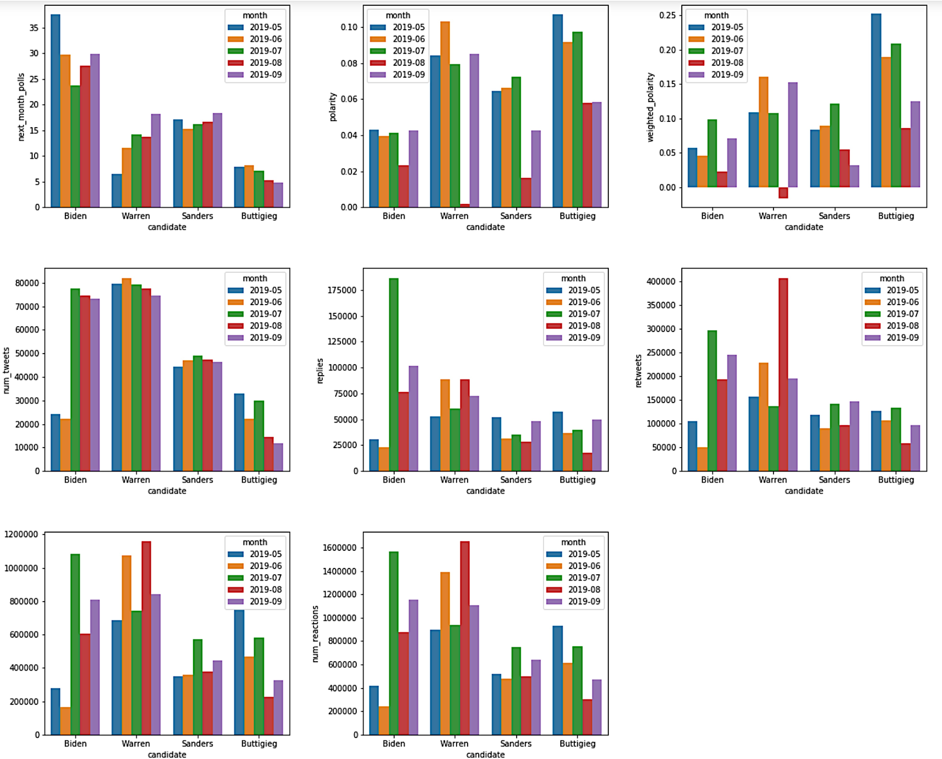
Visualizations Features by Month and Candidate

Slide 10
Choosing a Model
Winsorized data to mitigate the effects of outliers
Scaled data since numbers were large and scales were different
Selecting feature set
With and without candidates as dummy variables
Creating new features
Linear regression
Time series
OLS, Lasso, Ridge, ElasticNet

Slide 11
Simple Liner Regression
The number of observations in training set is 32
The number of observations in test set is 8
R-squared of the model in the training set is: 0.726222892494
-----Test set statistics-----
R-squared of the model in the test set is: 0.3079798070878181
Mean absolute error of the prediction is: 0.6196307058104701
Mean squared error of the prediction is: 0.8512230084805525
Root mean squared error of the prediction is: 0.9226174767911
Mean absolute percentage error of the prediction is: 81.55921
With dummy variables:
-----Test set statistics-----
R-squared of the model in the test set is: 0.6999195681354926
Mean absolute error of the prediction is: 0.4908165218976471
Mean squared error of the prediction is: 0.36911548335449296
Root mean squared error of the prediction is: 0.6075487497760
Mean absolute percentage error of the prediction is: 123.6952

Slide 12
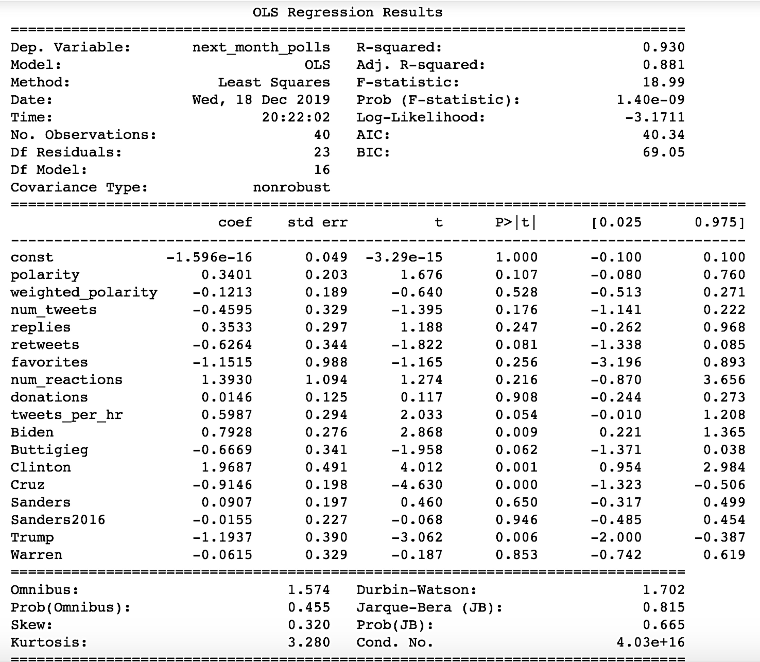
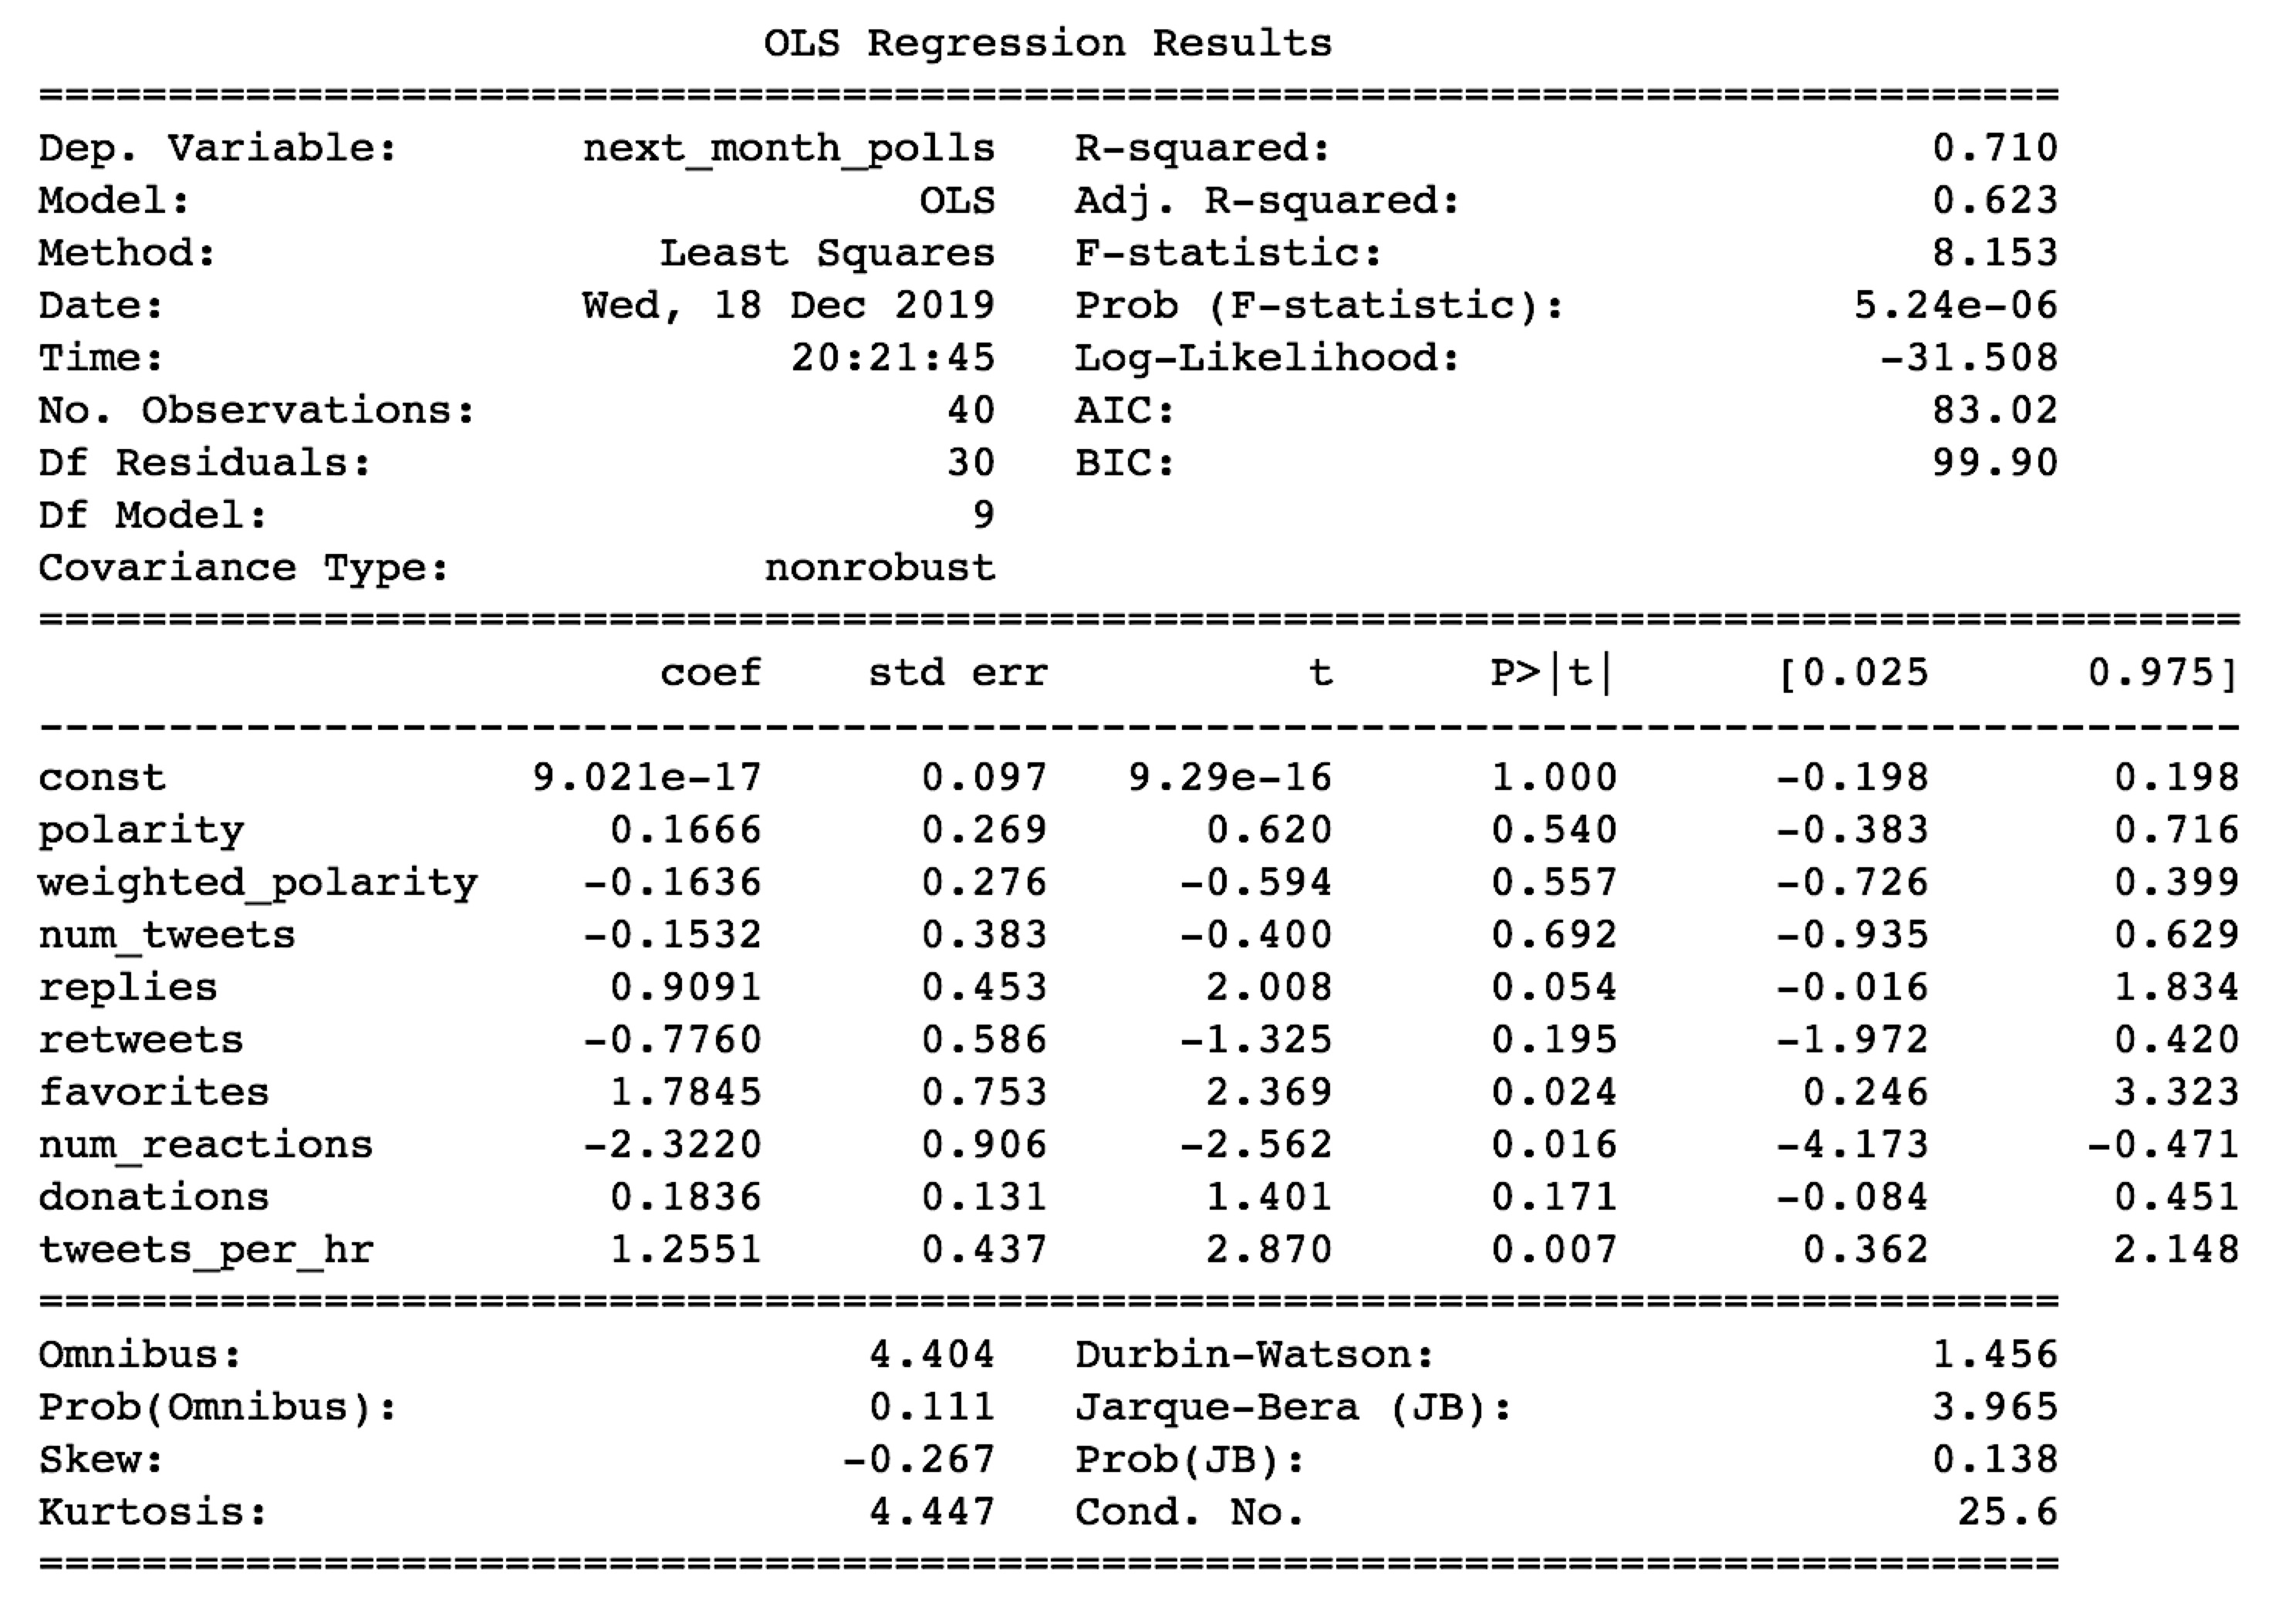
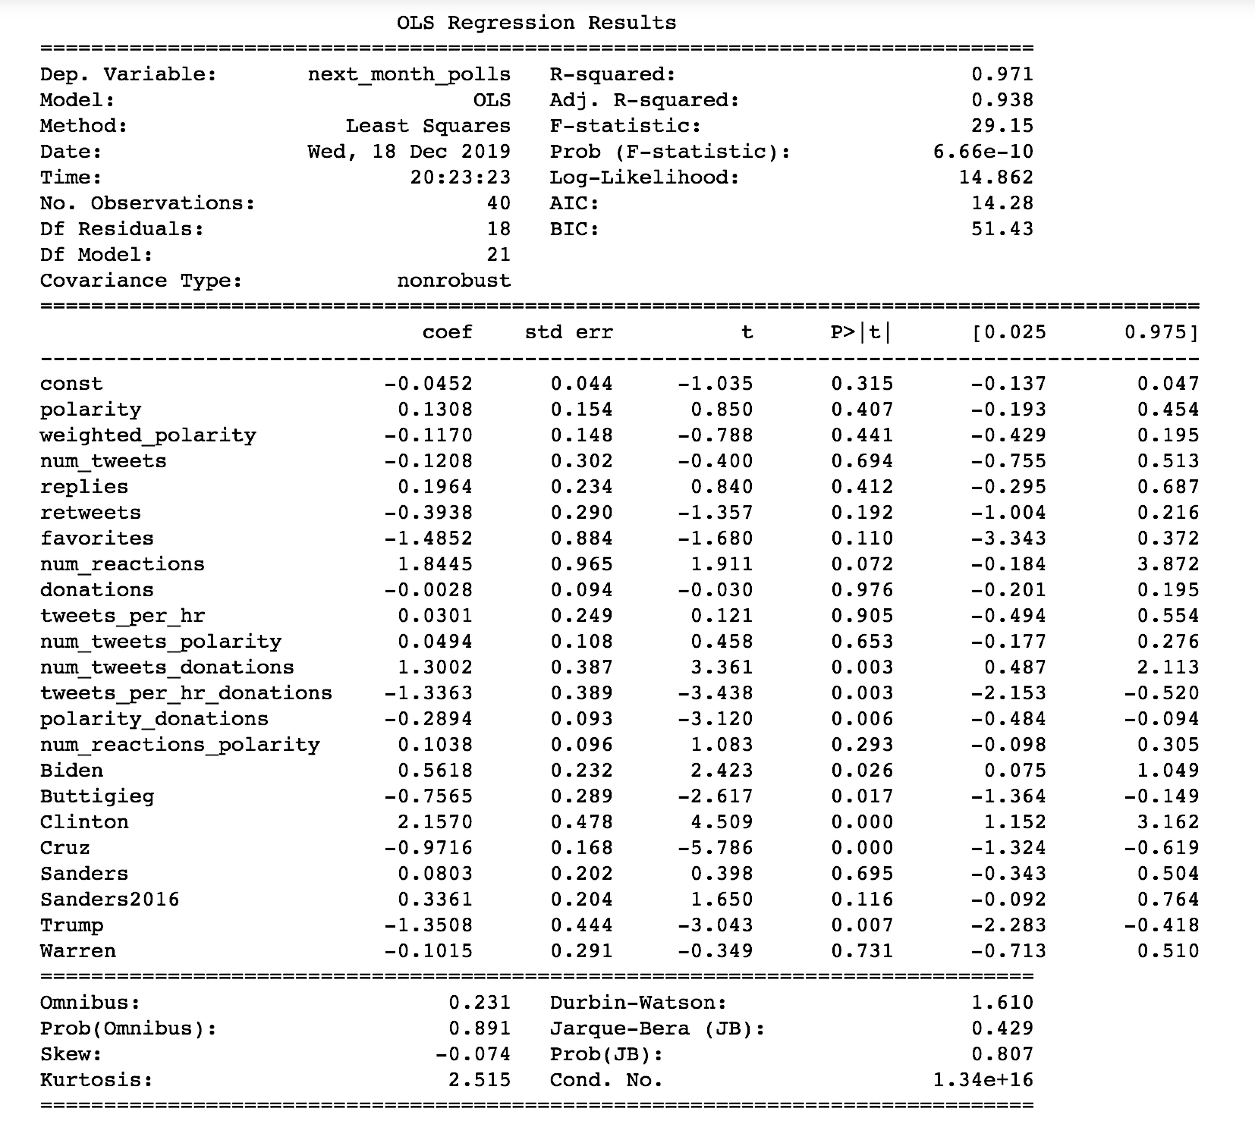
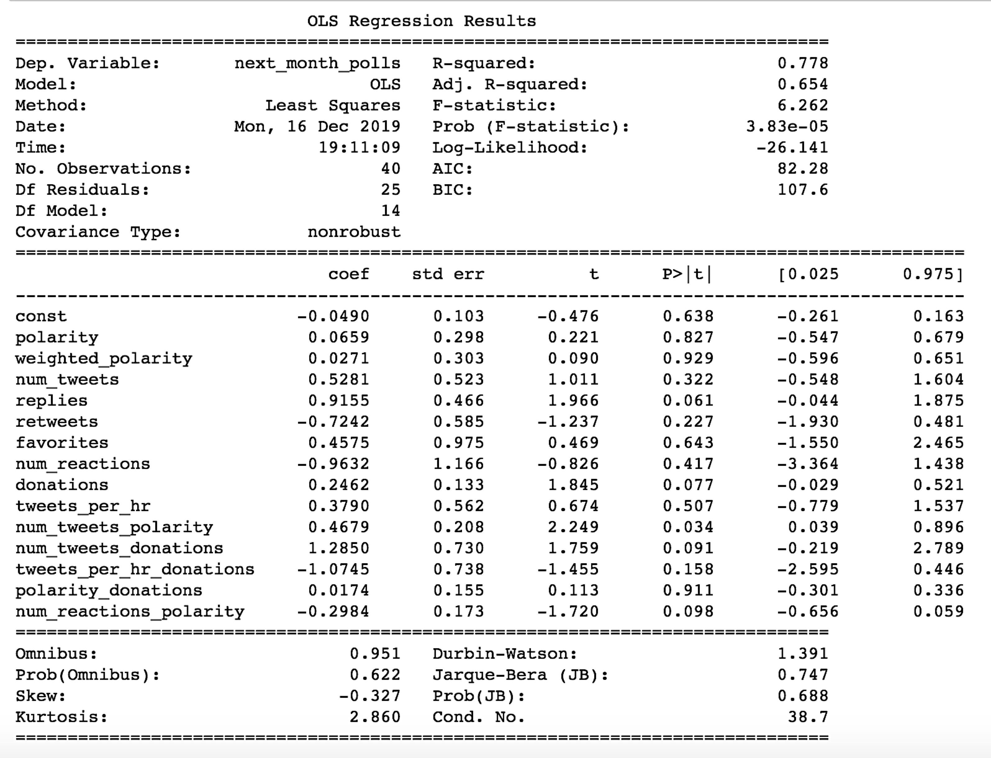
OLS

Slide 13
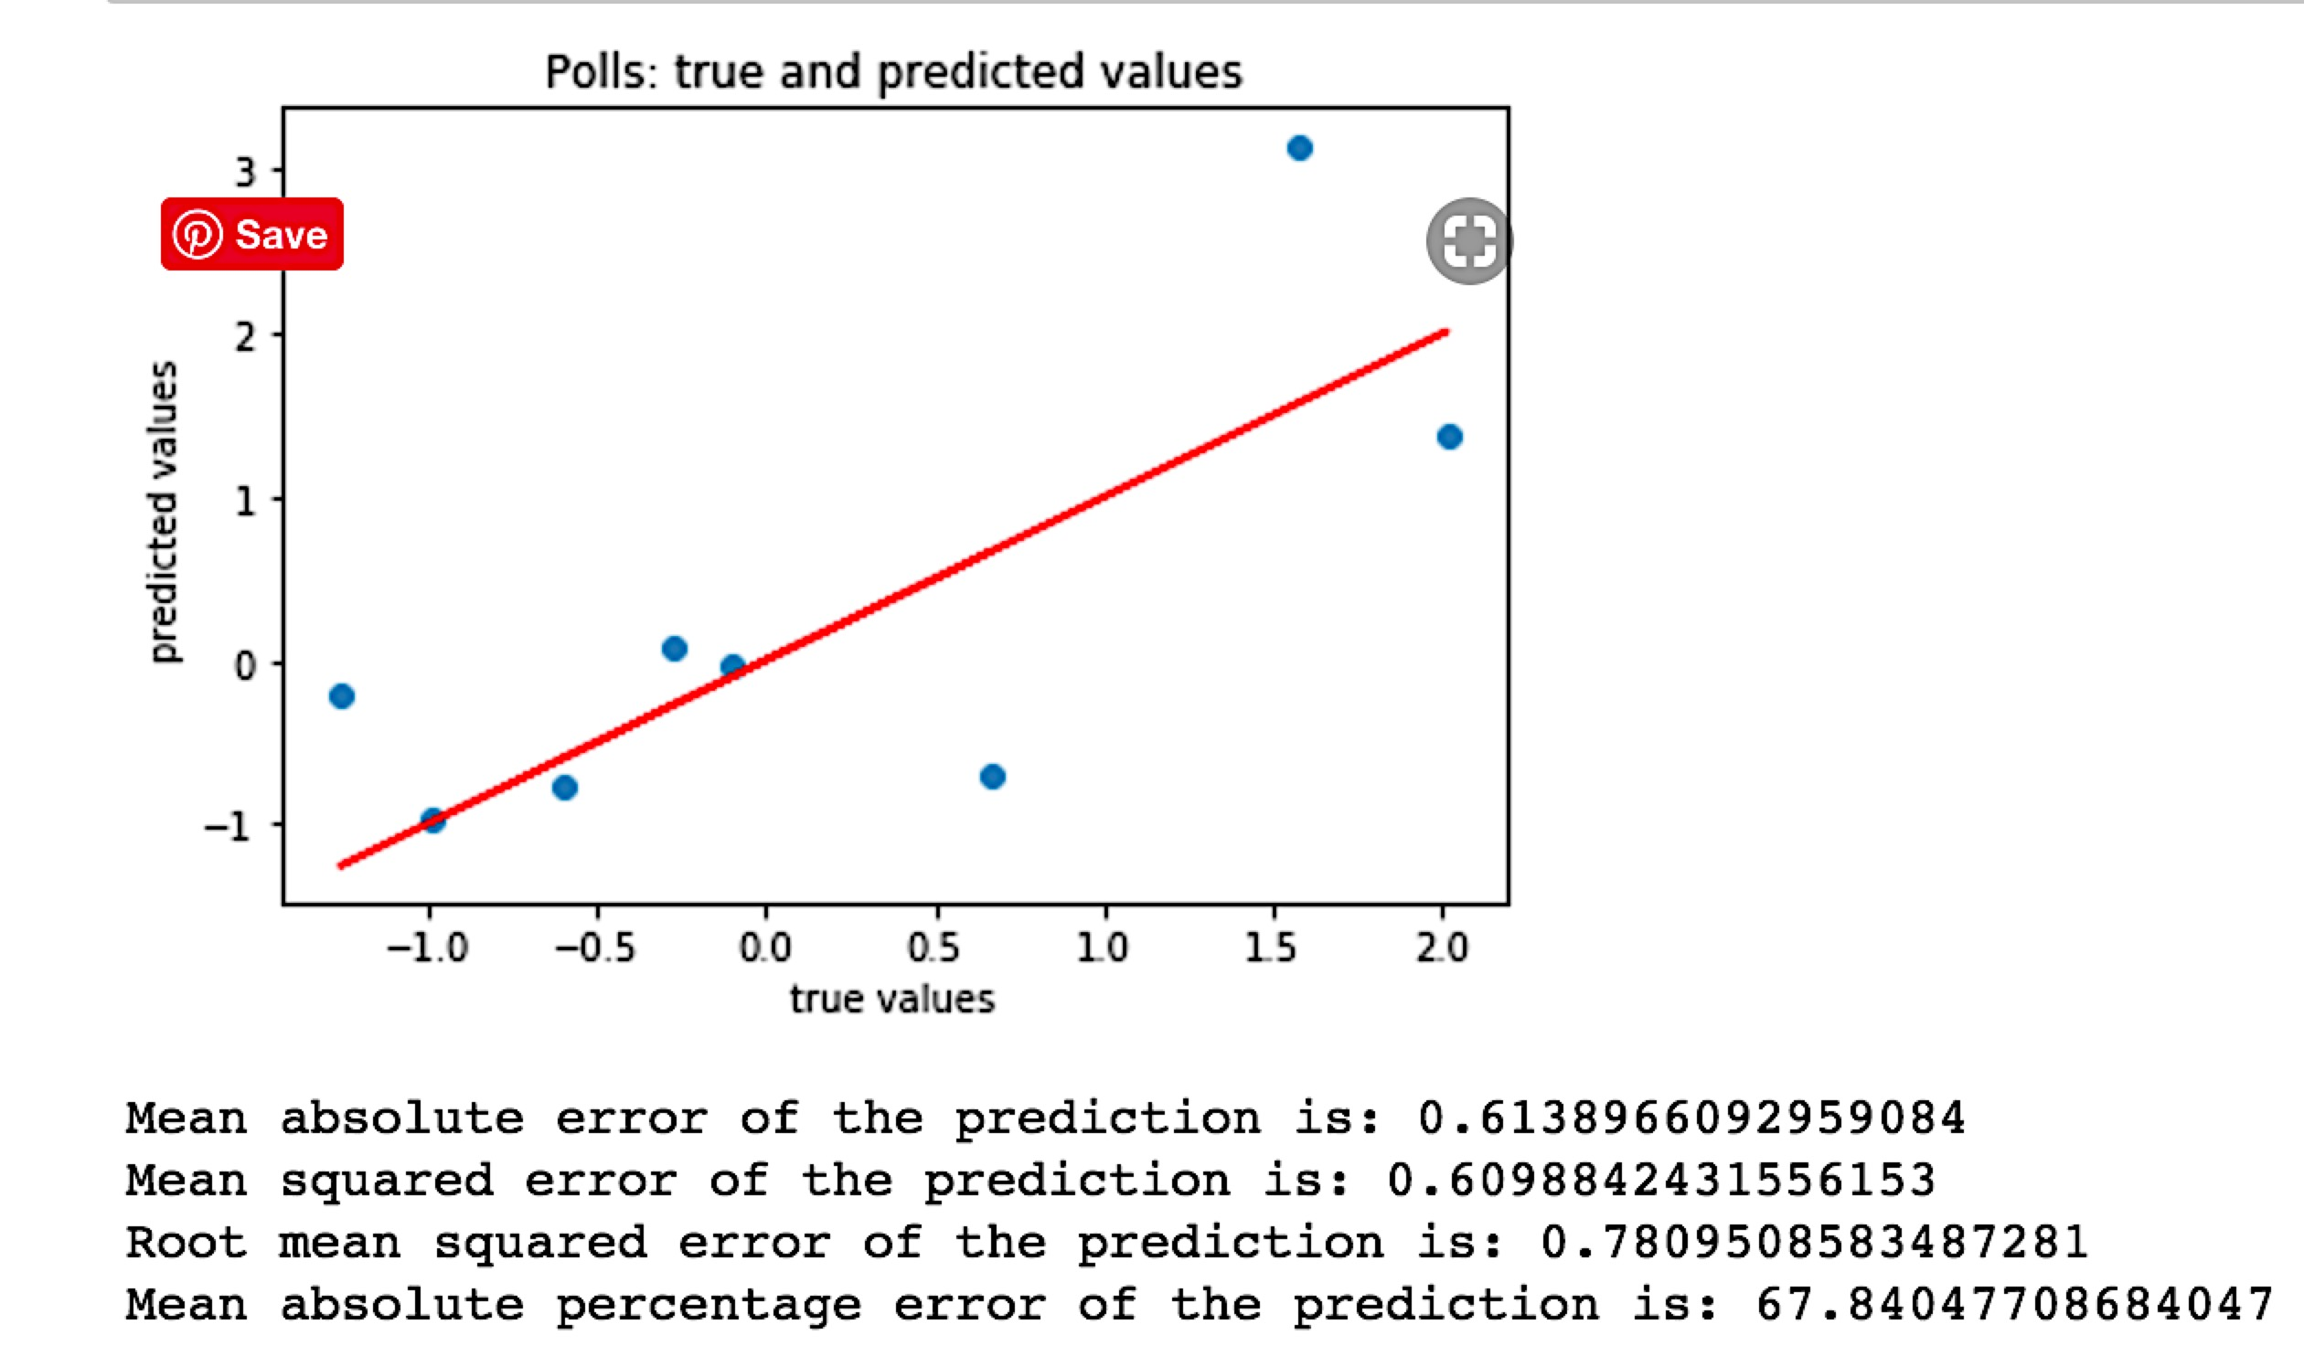
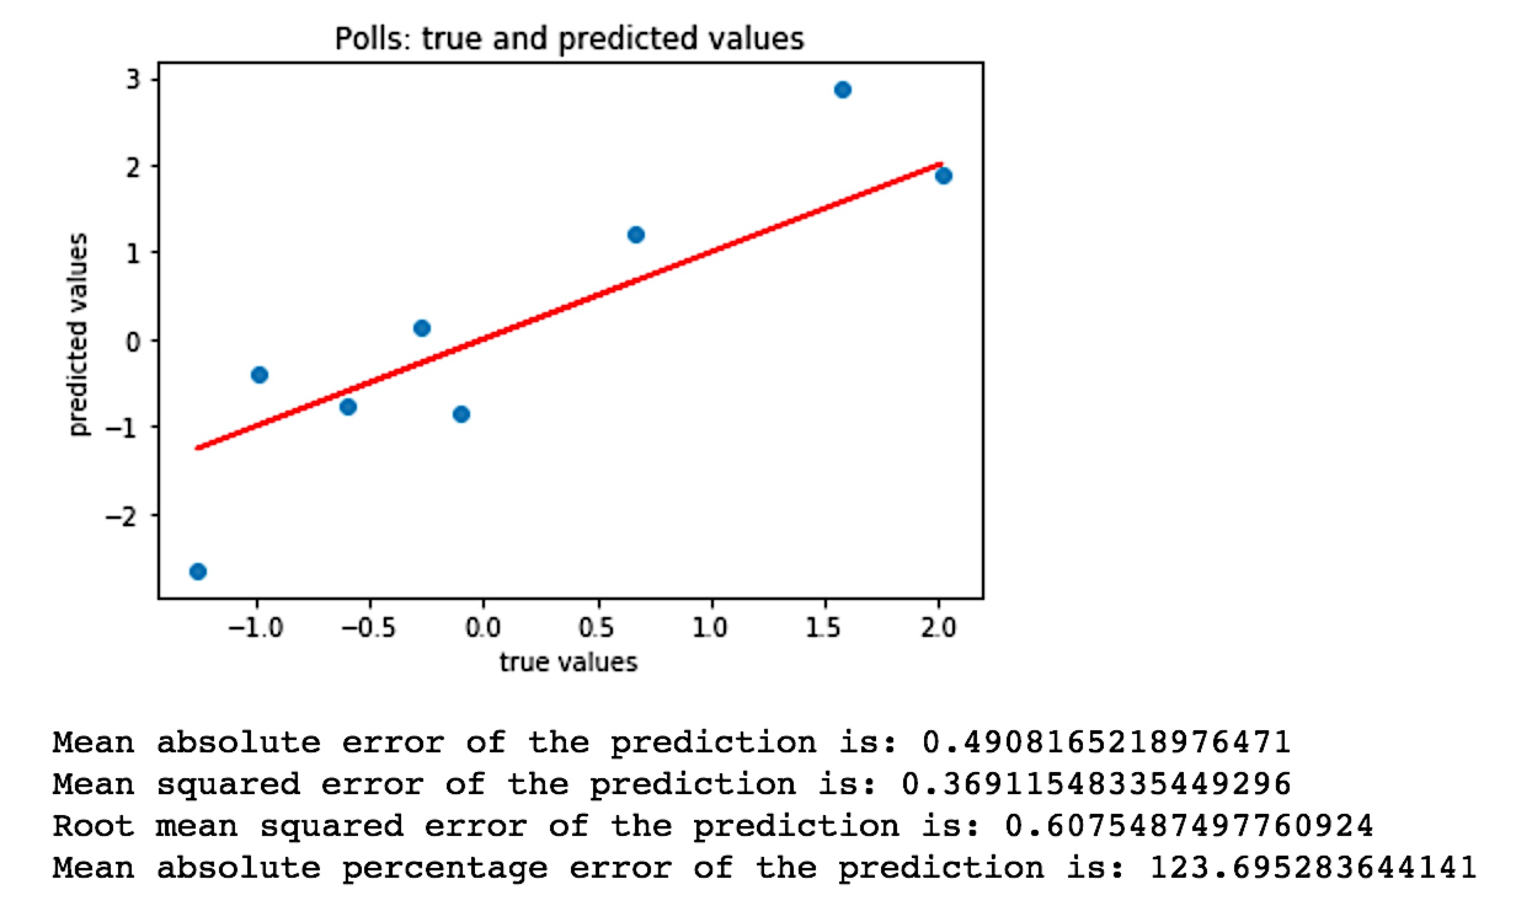
OLS without dummies
OLS with dummies

Slide 14
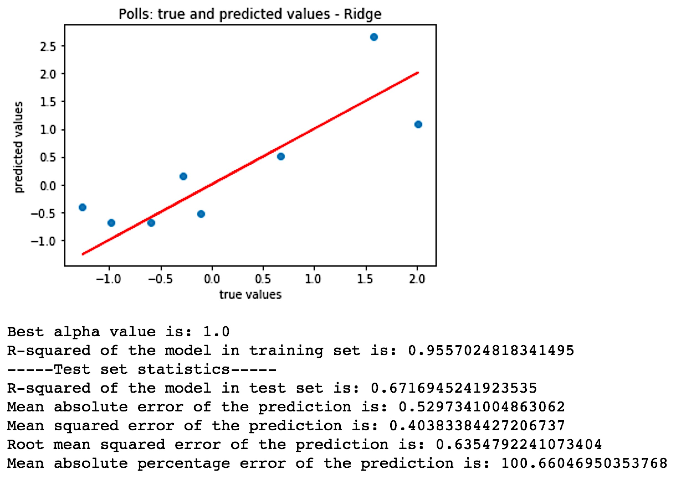
Ridge

Slide 15
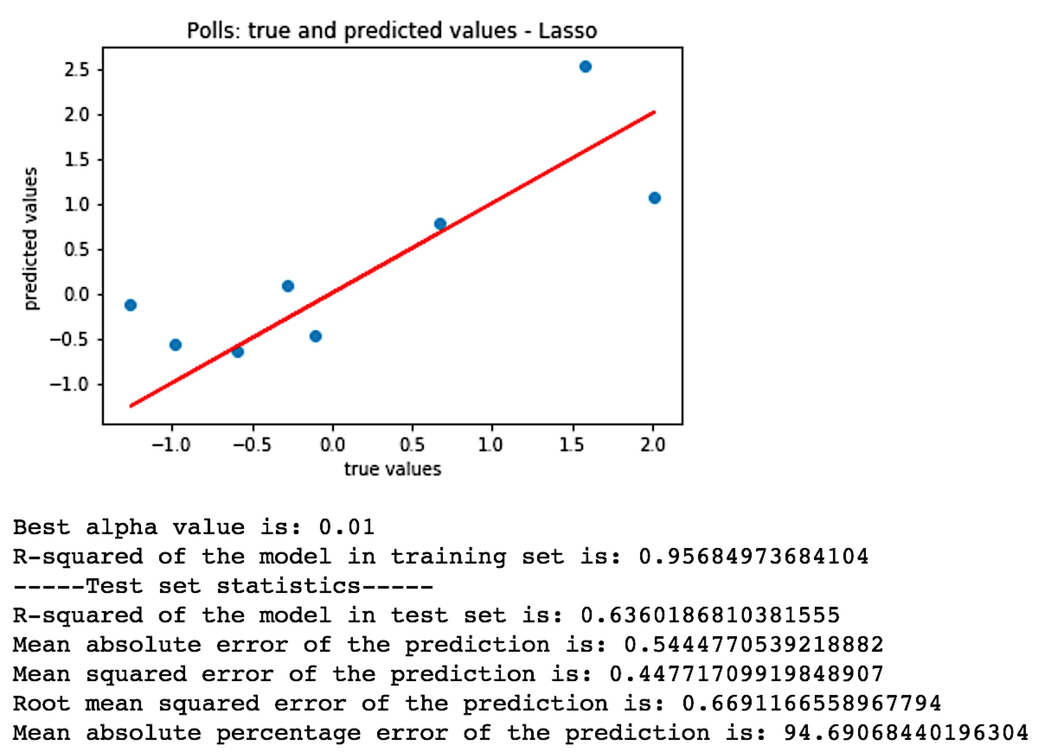
Lasso

Slide 16
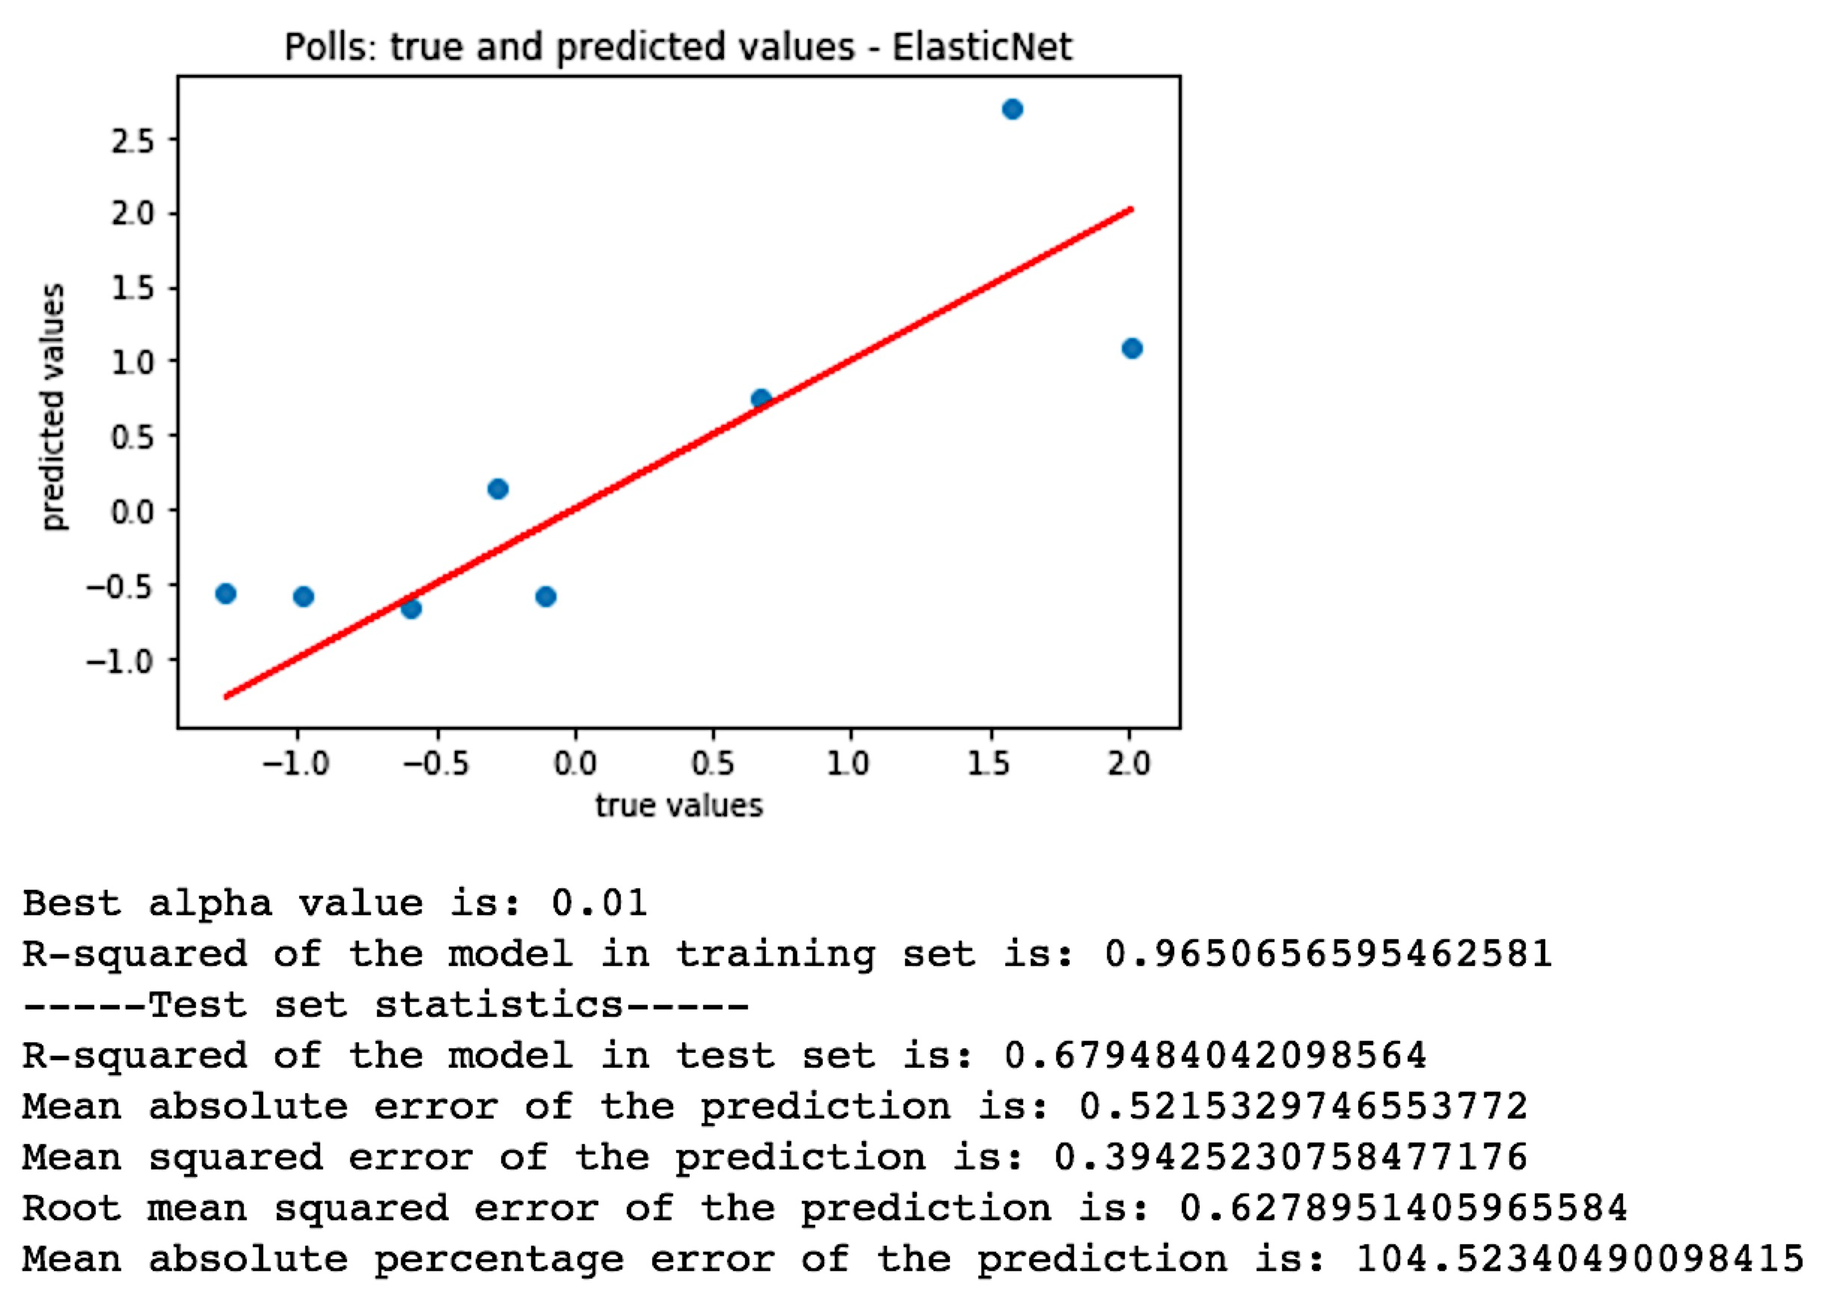
ElasticNet

Slide 17
Evaluating the Model
Adding more variables seems to make everything less statistically significant. Tweets per hr is the most significant variable, followed closely by number of reactions, favorites, and replies, which are all more or less the same measurement. The relationship between number of tweets and donations is interesting. The coefficient is 0.98 which I would take to mean the relationship is 1 to 1--for every tweet, there is a correlating $1 donation on average each month.
In both versions of the OLS model (the one without added variable interactions and the one with the added variable interactions), the P-value for the F-statistic is very close to 0, meaning that our features add some information to the reduced model and our model is useful in explaining polling data. However, F-tests don't quantify how much information our model contributes--this requires R-squared.
The R-squared of our polling predictions model is 0.778, which means it explains about 78\% of the variance in the model. After adding the 4 extra interactive features, the R-squared went up 0.06 which indicates that the interaction of the variables explains some previously unexplained variance in the charges. There is room for improvement here, but with an R-squared value of 0.78 we probably don't need to worry about over-fitting at least. Adjusted R-squared does the same job as R-squared, but it is adjusted according to the number of features included in the model. Our adjusted R-squared isn't too much lower than our R-squared (0.654), which is a good sign.
The two models above are relatively equal in terms of which one is better than the other when considering R-squared, F-stat, AIC, and BIC, but the model with the additional features is slightly better.
At first look, when we add the candidates as dummy variables, the R-squared is really high, wow, that's great! But...I think there is some over-fitting going on here because of the amount of variables this adds, since there are 8 new columns now. Then again, the R-squared of the training set is 0.9626 and the R-squared of the test set is 0.6999. These numbers are actually pretty close together, which indicates that overfitting might actually not be a factor. Regardless, it might show some interesting results, so we'll keep both models with the dummy variables and without.

Slide 18
Possible Issues and Improvements
Missing some data from the 2019 political candidates because of the download package I chose (Twint), and there was a higher volume than in 2015
Not a long enough span of time for data collection
Could be improved by gathering data from more months and/or more days from each month
Too many candidates
Data quality could have been improved by just focusing on 2 frontrunner candidates for each election cycle
Geographical data from tweets could be used to predict primary results
Tweets could have been scrubbed for filler words such as: I, a, the, and, on, as, if, of, be, for… etc. and then used sentiment analysis

